Slide 1






VC2 2020
KICK OFF – MONDAY JUL 6

Slide 2

MON
JULY 6
KICK OFF
FRI
AUG 14
FINAL PRES
5 WEEKS
ITERATIONS
VC2

Slide 3

Full time during 6 weeks
6 HOURS PER DAY
From July to August 14th

Slide 4
ANALYSIS
DESIGN
WHAT IS THE ORDER ?
Experience the whole process of development of an application
IMPLEMENTATION
TEST
DEPLOYMENT
COSTING/PLANNING

Slide 5
CODE IGNITER
GIT
LARAVEL
PHP
HTML/CSS
DB
ENGINEERING
JS
FIND THE USELESS SKILL
Practice and use nearly what you learned at PNC.
AWS
CLEAN CODE
BOOTSTRAP
UX
COMPOSER
UML
GITHUB
FOOTBALL

Slide 6


Organize you work in team
Self-learning

Slide 7




Students Group
Development team of the virtual company
Manage their “internal organization”
Customer
Express needs
Project Manager
Assign tasks to the development team.
Set deadline
Control the progress
Support technically the team
PNC Tutor
Observe and assess students behaviors.
Work organization.
Support the team for organization and soft skills

Slide 8
Weekly meeting on Friday or Saturday, Monday
She/He’s the one who expresses the needs
on the student demonstration Expresses :
what he does not like
What needs to be updated for the next iteration
CUSTOMER

Slide 9

TUTORS keeps observing students’ behaviour's when dealing with the customer
How leader communicate with the customer
How leader delegate the project task (between the leader and the members)
How leader manage tasks and keep track on their project’s progression
How students behave during the meeting
TUTOR

Slide 10
Issues monitoring
Technical assistance
PROJECT
MANAGER

Slide 11
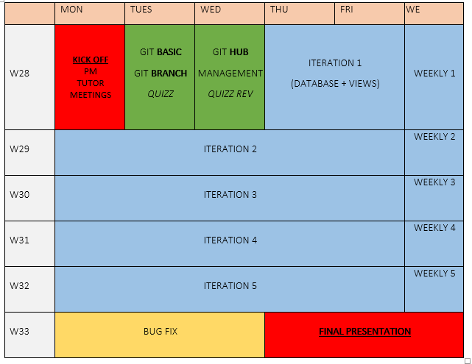
PLANNING

Slide 12
MON, 6 JUL
FRI, 14 AUG
Individual
Presentation
Kick Off
Weekly
Weekly
Weekly
Weekly
Weekly
ITERATION 1
ITERATION 2
ITERATION 3
ITERATION 4
ITERATION 5
1
2
3
4
5

Slide 13
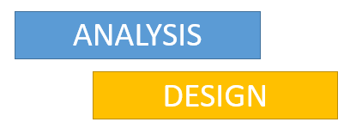

A iteration- based process
ITERATION 1
ITERATION 2..3
ITERATION 4..5

Slide 14




2 meeting per week : kickoff + weekly
BUGS FROM
PREVIOUS ITERATION
FEATURES FOR
THIS ITERATION
ITERATION
KICK OFF
WEEKLY
BUGS TO FIX

Slide 15

The team leader
Changes every week
Everyone will be leader
Write the GitHub issues for the week
Assign the milestone, the student and monitor them every day
Communicate with customer
Plan the meeting, send a list of questions
Lead the meeting
Demonstration – Q/A - Minute meeting and work log

Slide 16

The leader of the next week write the report
Demonstration – Q/A
Minute meeting and work log
ITERATION 1
WEEKLY 1
ITERATION 2

Slide 17
Your planning for this week
MON
TUES
WED
THUR
FRI
7,30
KICK OFF
MEETING
ITERATION 1
GIT
WORKSHOP
GITHUB
PROJECT
MANAGEMENT
TUTOR
MEETING
DATABASE
&
VIEWS
1;00
PROJECTS
MEETING
QUIZZ
QUIZZ REVIEW
WEEKLY
MEETING

Slide 18




GIT TRAINING
WHAT YOU NEED :
YOU HAVE GIT ON YOU MACHINE
YOU HAVE GITLENS
VSCODE EXTENSION
YOU HAVE A GIT
ACCOUNT
YOU READ THE GIT
SLIDES BEFORE TOMORROW 7 AM

Slide 19
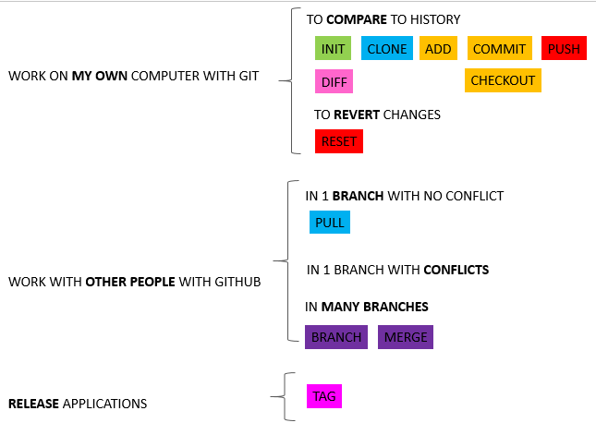
GIT TRAINING
WHAT YOU WILL LEARN

Slide 20
GITHUB TRAINING
WHAT YOU WILL LEARN
Assignee
Type
Milestone
How to create an issue
How to monitor an issue
How to link GIT commit to this issue
How to interact with customer using the issue
How to define a milestone
How to view the developer statistics
How to filter the list of issues

Slide 21
Your planning for NEXT week
MON
TUES
WED
THUR
FRI
7,30
CLEAN CODE
WORSKHOP
AWS
WORSKHOP
ITERATION 2
WEEKLY
MEETING

Slide 22
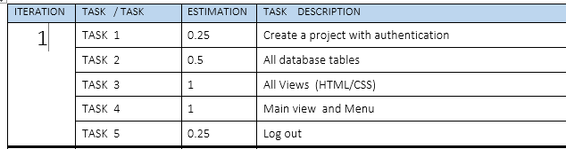
How to read your project specification?
Estimation of days
For 5 students
Task to be performed
On Iteration 1

Slide 23
VC2 2020 EVALUATION

Slide 24
MON, 6 JUL
FRI, 14 AUG
Individual
Presentation
Kick Off
Weekly
Weekly
Weekly
Weekly
Weekly
ITERATION 1
ITERATION 2
ITERATION 3
ITERATION 4
ITERATION 5
1
2
3
4
5
Evaluation
Evaluation
Evaluation
Evaluation
Evaluation
Evaluation
FINAL GRADE

Slide 25
1
2
3
5
4
Iterations Grades
Individual
Presentation
(IT1 + IT2 + IT3 + TI4 + IT5)/5
85 %
15 %
FINAL GRADE

Slide 26
EACH WEEK, ONE ITERATION GRADE IS GIVEN
PROJECT
MANAGER
CUSTOMER
TUTOR
50%
30%
20%
ITERATION GRADE

Slide 27
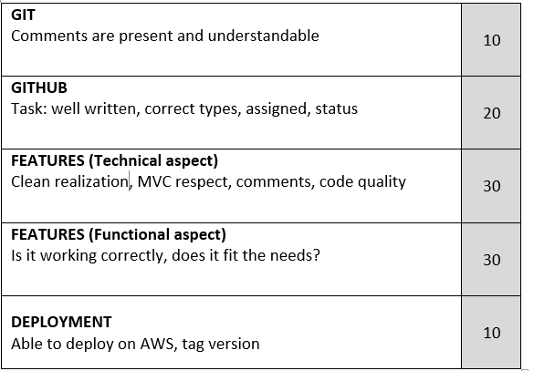
50%
PROJECT MANAGER
Evaluation

Slide 28
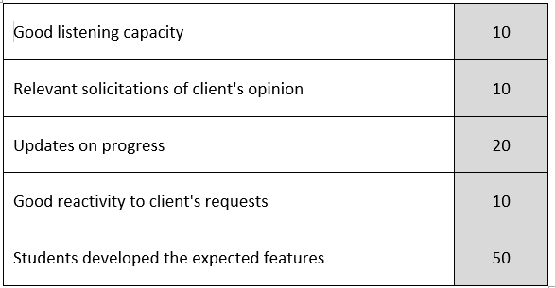
30%
CUSTOMER
Evaluation

Slide 29
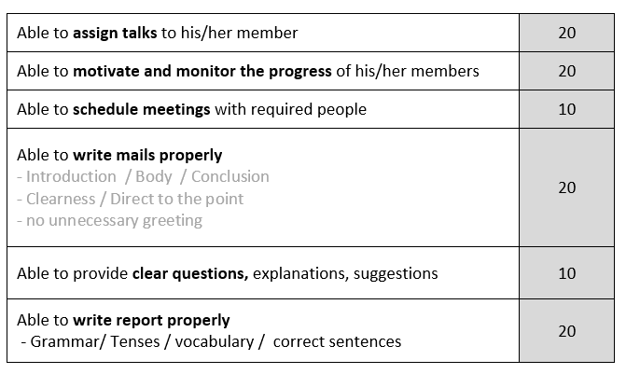
20%
TUTOR
Evaluation

Slide 30
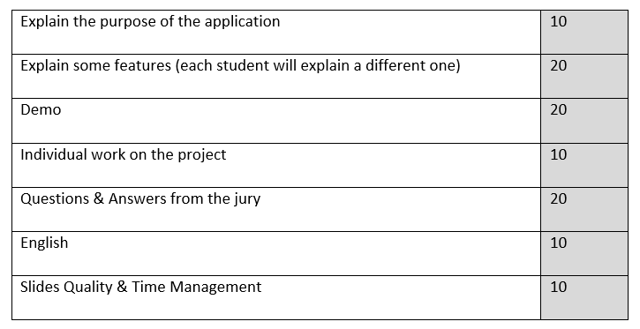
FINAL
PRESENTATION
Evaluation

Slide 31
FINAL INDIVIDUAL
Presentation
AUG 14

Slide 32
VC2 2020 GROUPS

